Slide 1

Weather teller

Slide 2
Submitted by
Md. Jahid Hasan Pintu
Id: 201002001
Parvez Mosaraf
Id: 201002995

Slide 3
Content
Introduction
Objective
Tools
Implementation Process
Output Screen Shot
Future Scope
Conclusion

Slide 4

Introduction
Weather forecasting is the application of science and technology to predict the conditions of the atmosphere

Slide 5
Objective
The main goal of the Weather Teller app is showing the current and real time weather
conditions :
● Showing Temperature
● Humidity
● Cloud condition
● Temperature Feel

Slide 6
Tools
● Nano (As code editor)
● VS Code (As code editor)
● Bash /Shell Scripting (As programming language)
● Open Weather API
● JSON
● Necessary linux commands

Slide 7
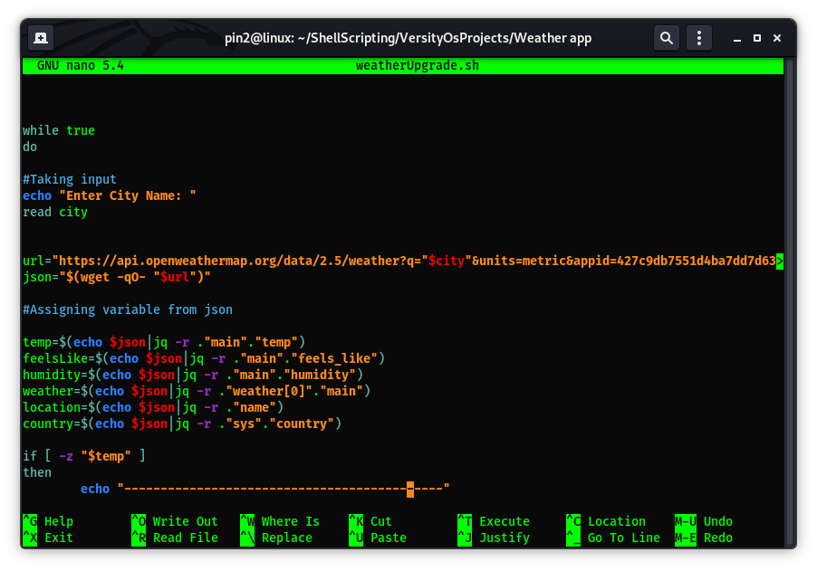
Implementation Process

Slide 8
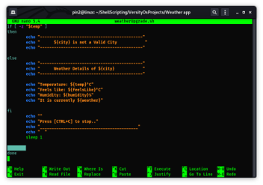
Implementations Process

Slide 9
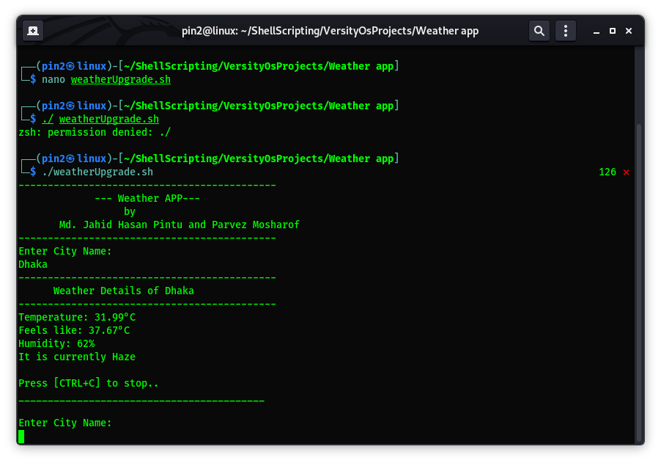
Output Screen Shot

Slide 10
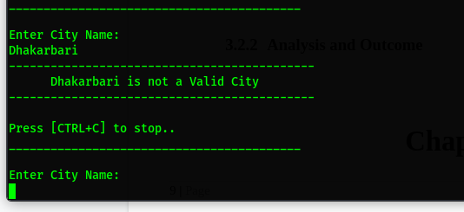
Output Screen Shot

Slide 11
Future Scope
There is lots of work that can be done in this project. We are determined to do the tasks given
below:
1.Weather condition related perfect icon can be shown
2. Earthquake alert
3. Cyclone alert
4. Emergency contact support
5. Realtime location tracking

Slide 12
Conclusion
This app is very helpful in our practical days because every person needs to know the weather
update all the time to become safe when they are traveling long distances or farmers can protect
their crops from natural calamities.

